Slide 1
CAS Products Update
AACP Admissions Workshop 2019

Slide 2
Recently Delivered

Slide 3
Added Program Name to PDF Header on Page 1
Live Now

Slide 4
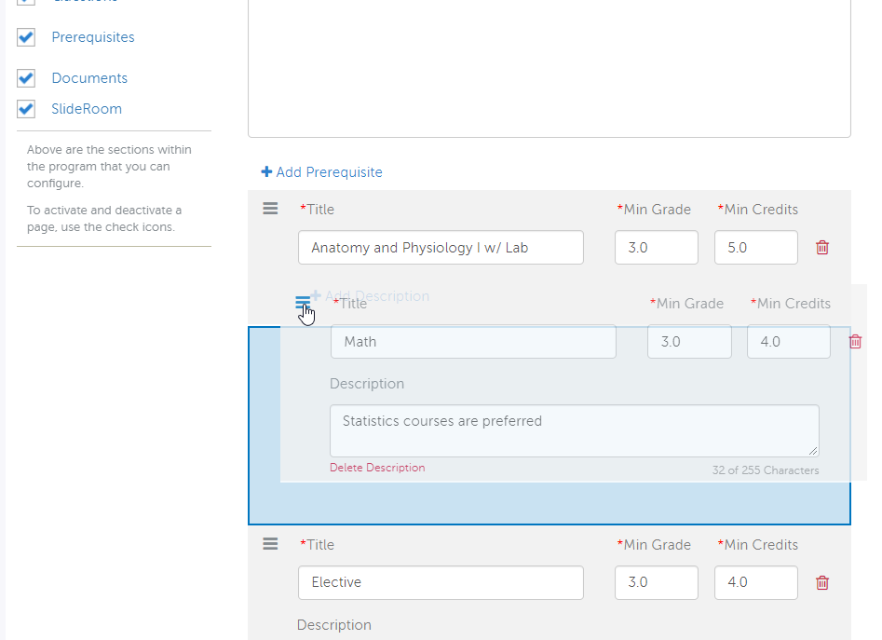
Drag and Drop Prerequisites (Config Portal)
Live Now

Slide 5
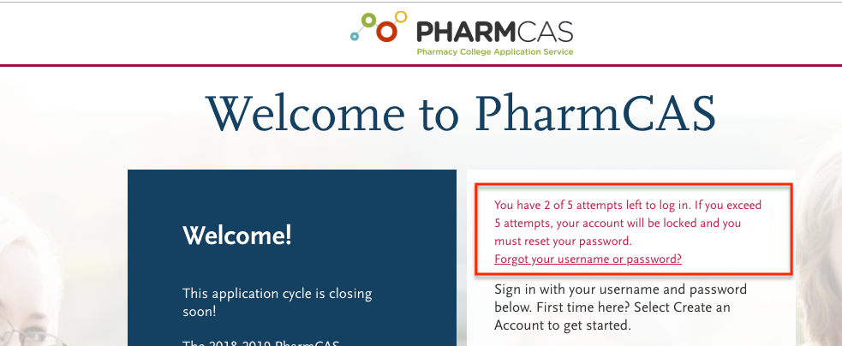
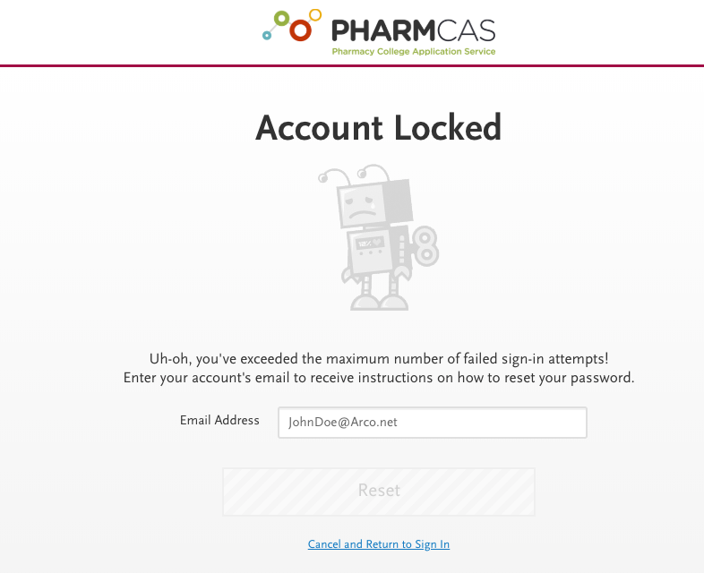
Security Upgrade – Account Lockout
Live Now

Slide 6
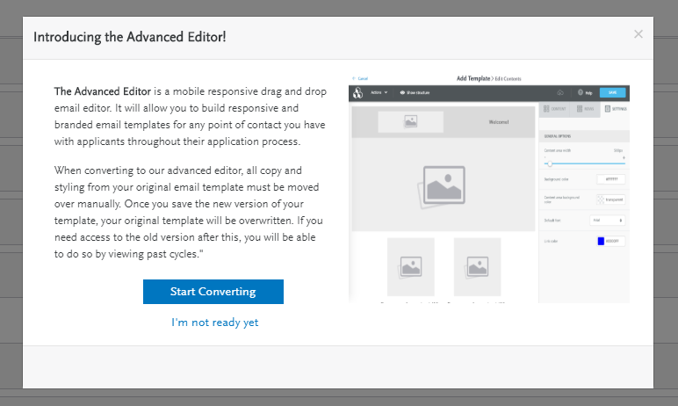
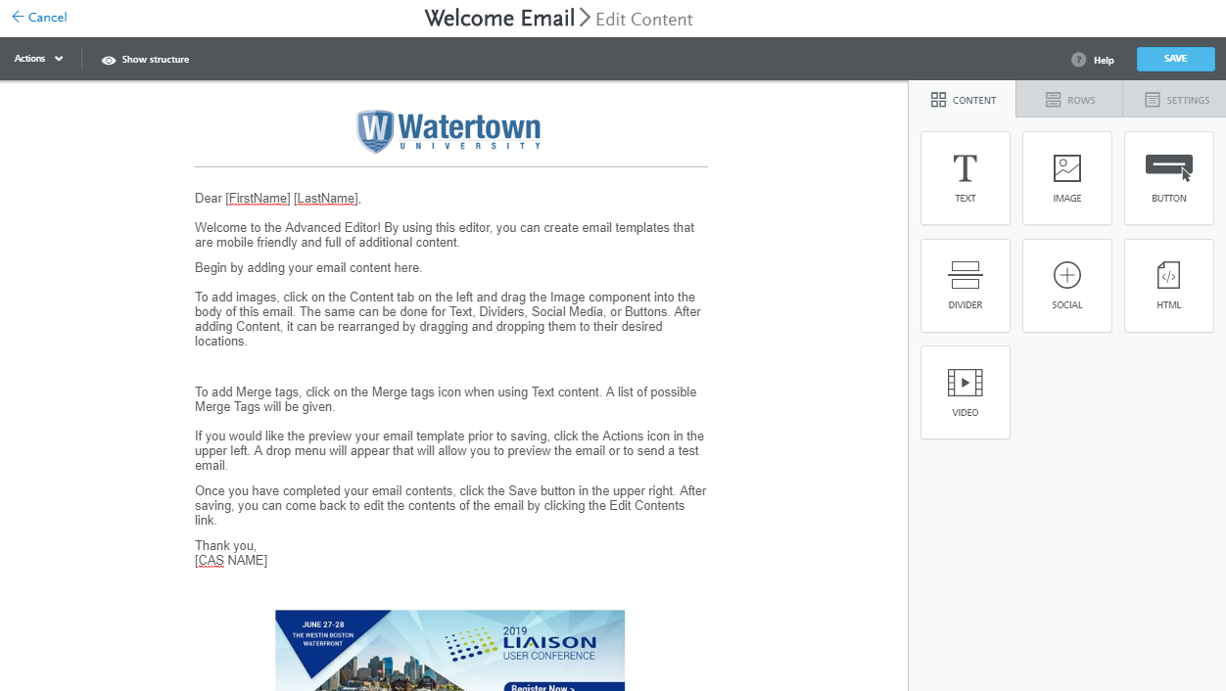
App Builder – Rich Email Templating Upgrades
Live Now For
Association Users
Only

Slide 7
Coming Soon

Slide 8
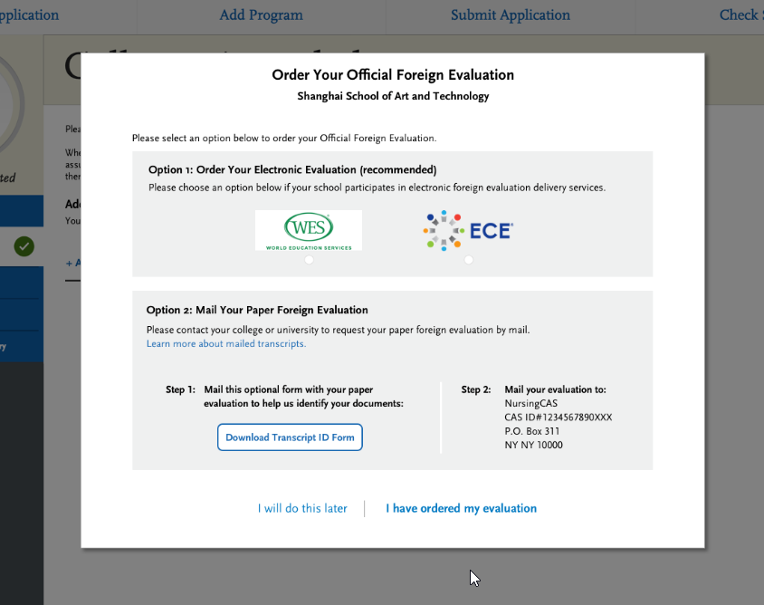
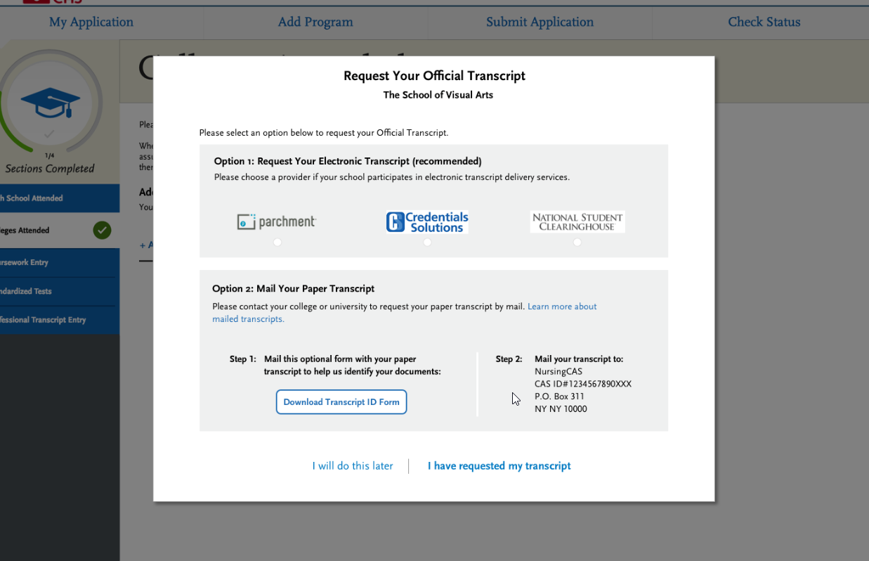
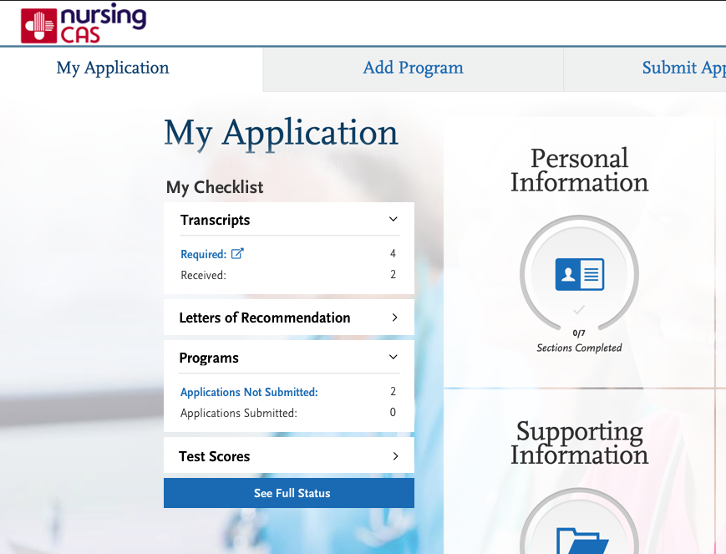
Improved Transcript Request Workflows
Emphasize e-transcript delivery, better alerting to applicants of requirements, de-mystify the process
TARGET – LATE SUMMER

Slide 9
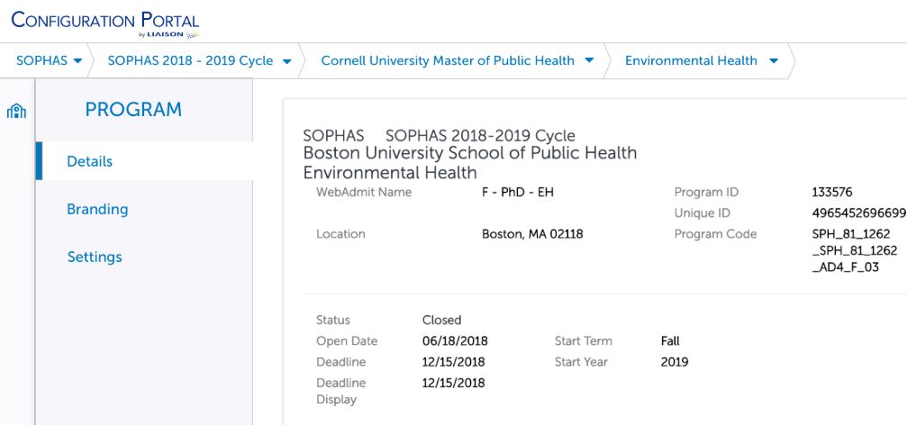
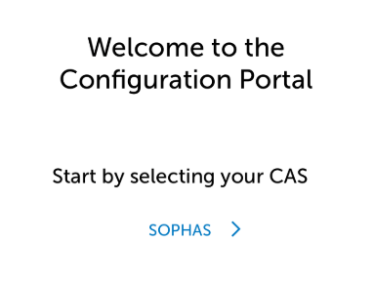
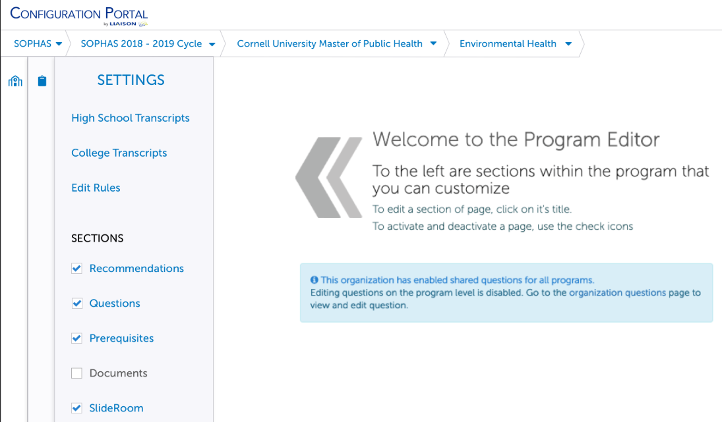
Config Portal UX Cleanup (part 2)
Target
Late
Summer /
Early Fall

Slide 10
Additional Enhancements Coming Soon
Ability to re-order Documents in Config Portal (Target June/July)
Allow Hiding of Specific Q4 Questions from PDF (Target July)

Slide 11
Q & A

