Slide 1
PharmCAS 2018-2019 (Adding a new cycle to existing users)

Slide 2
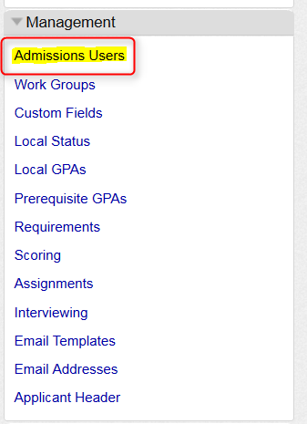
Go to the Management Panel
- All WebAdMIT Administrators will have access to the Management Panel. This is located on the left navigation of your homepage.
- To update your users, click on “Admissions Users”

Slide 3
Select desired user and click on the pencil icon:

Slide 4
Organization assignments & cycle years are listed:
Organizations and cycles with a Green Plus sign indicates that the cycle is not activated for the user
To add the new cycle, click on the Green Plus sign

Slide 5
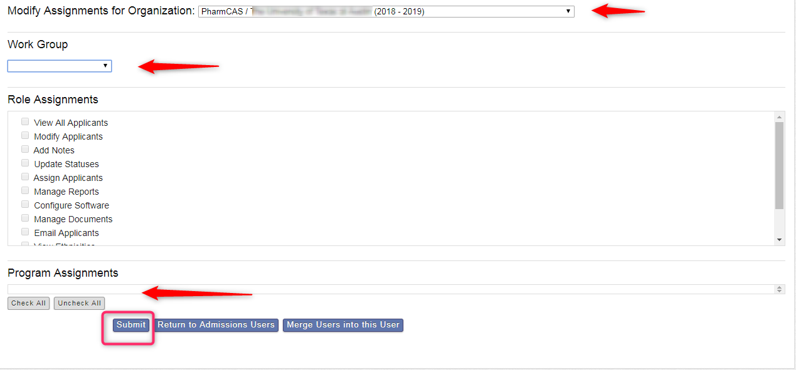
Add appropriate Work Group, Cycle and Program Assignments
Once all selections are made, click “submit” to save changes
Program Assignment box will display the appropriate CAS you are assigning access to once the organization has a live program.

Slide 6
Questions?
Your
PharmCAS Team:
Nicole Iarossi Melissa Keaveney
Customer Solutions Manager Account Manager
niarossi@liaisonedu.com mkeaveney@liaisonedu.com
Thank you!

