Slide 2
New Deans Orientation

Slide 3
AACP Mission and Vision
AACP Mission
Advance pharmacy education, research, scholarship, practice and service, in partnership with members and stakeholders, to improve health for all.
AACP Vision
We envision a world of healthy people through the transformation of health professions education.
Organizational Chart (in folder)

Slide 4
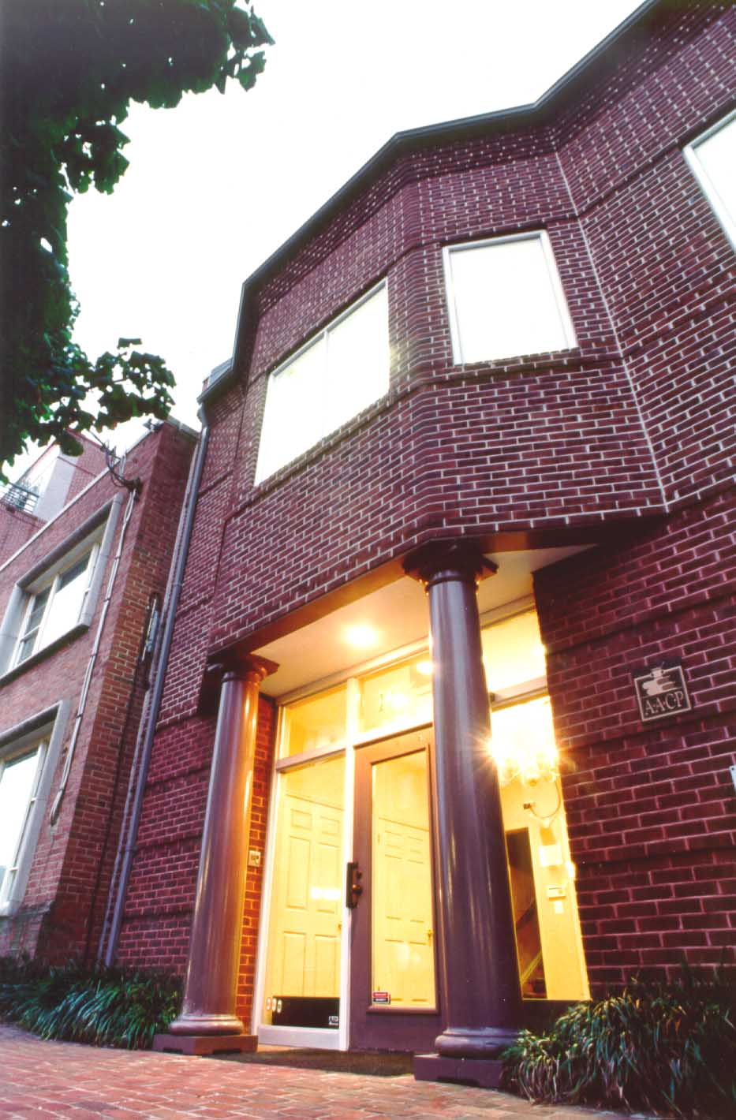
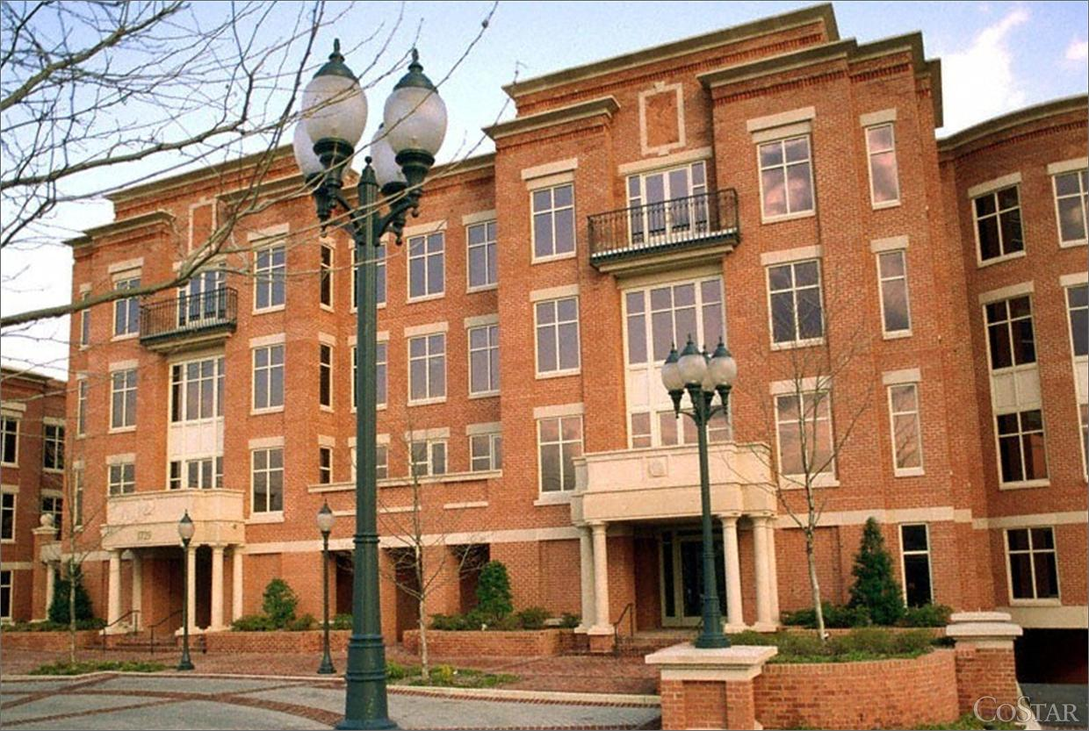
Old Town Offices (1988-2018)

Slide 5
Crystal City Office

Slide 6
AACP Connect

Slide 7
AACP.ORG

Slide 8
2016 AACP Strategic Plan
Strategic Priority 1: Enriching the Applicant Pipeline
Strategic Priority 2: Creating a New Portrait of Pharmacists and Pharmacy Careers
Strategic Priority 3: Innovation in Education and Practice
Strategic Priority 4: Expanding Research & Graduate Education

Slide 9
Governance and Engagement Opportunities
Board of Directors
House of Delegate
Council of Deans
Council of Faculties
Committees
Sections/Council of Sections
SIGs/SIG Cabinet
Elections

Slide 10
Types of Meetings
Annual
Interim
Institutes
Leadership Fellows/Catalyst
District/Regional
Webinars

Slide 11
Discussion
Introduce yourselves and identify one topic you would particularly like to spend time on in group discussion (AACP product, priority, a problem how aim to solve).
Describe additional leadership opportunities needed for CEO Deans? Other Deans? Department Chairs? Faculty?
How can your college/school deepen its engagement with AACP and the priorities in the strategic plan (recruitment, branding, practice/education transformation, research and graduate education advancement)?

Slide 12
Later This Afternoon
2:00p.m.-3:30p.m. Connections and Conversations: CEO Deans
3:45p.m.-4:45p.m. Deans Forum: The New Role of Academia in Drug Discovery and Development—New Thinking, New Competencies, New Results
5:00p.m.-6:00p.m. CEO Deans Networking Reception
6:00p.m.-7:00p.m. Welcome Reception

